Slide 1

R32V2020 32-bit RISC Processor in EP4CE6
Land Boards
2019-04-25

Slide 2
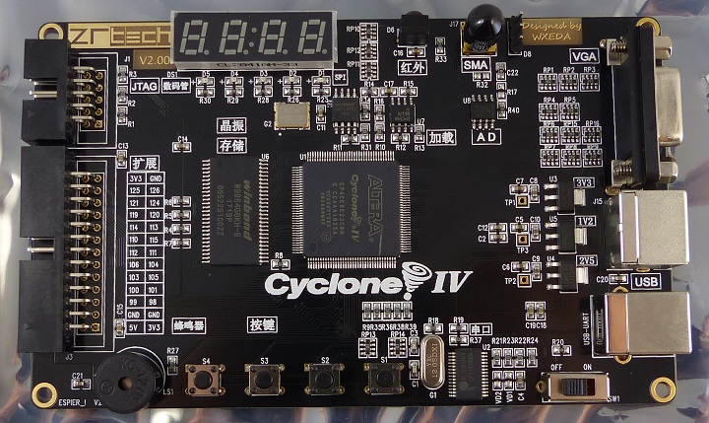
Target Hardware - Low End Off-the-shelf EP4 FPGA card
04/28/2019
R32V2020
<number>

Slide 3
EP4 On-card Resources
Hardware that has already been tested with the Multicomp project
Altera EP4CE6 FPGA – 50 MHz clock
USB-Serial
PS/2 keyboard
VGA
Keys, LEDs, Buzzer
4 digit, 7 segment display
04/28/2019
R32V2020
<number>

Slide 4
EP4 On-card Resources (cont’d)
Hardware not yet tested with Multicomp
SDRAM
Not required but would be nice for larger instruction space
A/D
IR receiver
Serial EEPROM
04/28/2019
R32V2020
<number>

Slide 5
VHDL Peripherals (tested with Multicomp)
VGA (2/2/2 video mode)
Memory Mapped character display (64x32)
ANSI terminal (UART emulation) display (80x32)
PS/2 Interface (connector on card)
UART
6850 ACIA (via USB-Serial interface)
Sound
Various from buzzes to tones
04/28/2019
R32V2020
<number>

Slide 6
Resources in Altera EP4CE6
Cyclone IV lowest end part
Logic Elements (LEs) = 6276
Embedded Memory (1Kx9 blocks) = 30
These elements set the resource budgets
04/28/2019
R32V2020
<number>

Slide 7
Architecture Blocks
Register File
16 regs
32-bits
ALU
8-bit
I/O
Ctrlr
VGA
Stack
RAM
xKx32
PS/2 Keyboard
PS/2 Keyboard
Instruction
RAM
xKx32
Instruction
Decoder
Data
RAM
xKx32
UART
USB
Hard-
ware
VHDL
Code
04/28/2019
R32V2020
<number>

Slide 8
Register File
16 registers (r0-r15)
32-bits per register
Some registers are dedicated and some are general purpose
All registers reset to known value
Most registers clear to zero at reset
Uses < 512 Logic Elements (LEs)
Less than 10% of the available EP4 LEs
04/28/2019
R32V2020
<number>

Slide 9
Register File (Cont’d)
Some registers are dedicated some are Gen Purp
r8-r15 = General Purpose registers (8)
r0 = always 0 (read-only – stores won’t change value)
r1 = always 1 (read-only – stores won’t change value)
r2 = always all 1’s (0xffff)
r3 = Condition Code
r4 = Stack Address
r5 = Peripheral Address
r6 = Data Address
r7 = Program Address (loadable or auto-increment)
04/28/2019
R32V2020
<number>

Slide 10
Separate Address Spaces
Four independent address spaces
Instruction Space
Peripheral Space
Data Space
Stack Space
There is plenty of interconnect in the FPGA
Reduces multiplexing
All writes are posted (don’t block the CPU unless the bus is busy from the last write
With internal SRAM for most spaces they won’t be
Peripheral bus could be busy with slow periph.
04/28/2019
R32V2020
<number>

Slide 11
Instruction Space
On-chip Dual Port RAM
Read-only from the CPU
Write-able from physical loader connection
32-bit instructions
Fixed instruction length (not ever variable)
Fields in consistent positions
16-bits of address in EP4 FPGA (extensible)
Designed for 32-bit addresses
EP4CE6 has limited space...
04/28/2019
R32V2020
<number>

Slide 12
Peripheral Space
Needs to work with current set of peripherals
Memory Mapped Display
Terminal
UART
Latches (LEDs, etc)
Read buffers (Switches, etc)
Address/Data match current peripheral space
16-bits of address is typically plenty
8-bits of data is typical
Reads/writes use bottom 8 bits of src/dest
Zero pad the rest of the bits when read
Could be 32-bits, for instance counters
04/28/2019
R32V2020
<number>

Slide 13
Data Space
On-chip Dual Port RAM
Data space is Read-Write from the CPU
16-bits of address in EP4 FPGA (extensible)
32 bits of data
Up to 64K Long words of data
Use is strictly limited to moves between Data Address Space and Registers
04/28/2019
R32V2020
<number>

Slide 14
Stack Space
Uses On-chip RAM
16-bits of address is more than enough since there's limited space in internal RAM
32 bits of data
Subroutine calls need the stack pushed/pulled automatically
Always Push registers at call
Pull most registers at return
Resources – stack depth
16 registers, 2K stack = 128 levels deep
Can’t corrupt address/instruction spaces
04/28/2019
R32V2020
<number>

Slide 15
Instruction Format
32-bits wide
8-bit wide OpCode
rZ,rX,rY (register/register oprations)
rX op rY => rZ
4-bit wide source1 register select
4-bit wide source2 register select
4-bit wide destination register select
Immediate format
4-bit wide source1 register select
16-bit wide immediate
2 instructions for 32-bit
04/28/2019
R32V2020
<number>

Slide 16
Opcode
See Opcode table spreadsheet
04/28/2019
R32V2020
<number>

Slide 17
Separate Address Space Busses
Most designs share multiplexed address/data bus
Expensive in chip area and unnecessary
Address space registers directly connect to the address lines of their appropriate SRAMs and peripheral bus
Pre-fetch is automatic
Write posting is natural
04/28/2019
R32V2020
<number>

Slide 18
Common I/O Function
Sit on a peripheral bus location and test a bit until peripheral has data or is ready for more data
Set the peripheral address register
Set the test condition in a register
Do peripheral read until condition is satisfied
Read bits, AND bit(s) branch if bit set/cleared
04/28/2019
R32V2020
<number>

Slide 19
Common I/O Function
Sit on a peripheral bus location and test a bit until peripheral has data or is ready for more data
Set the peripheral address register
Set the test condition in a register
Do peripheral read until condition is satisfied
Read bits, AND bit(s) branch if bit set/cleared
04/28/2019
R32V2020
<number>

